Slide 1
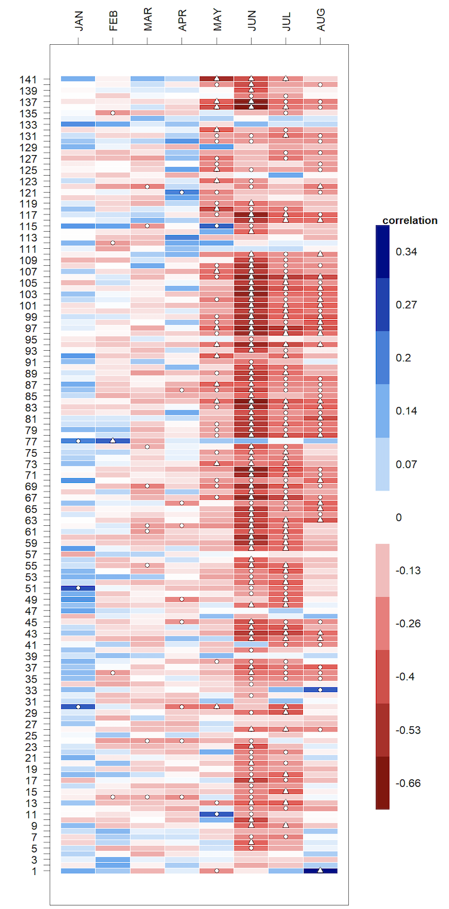
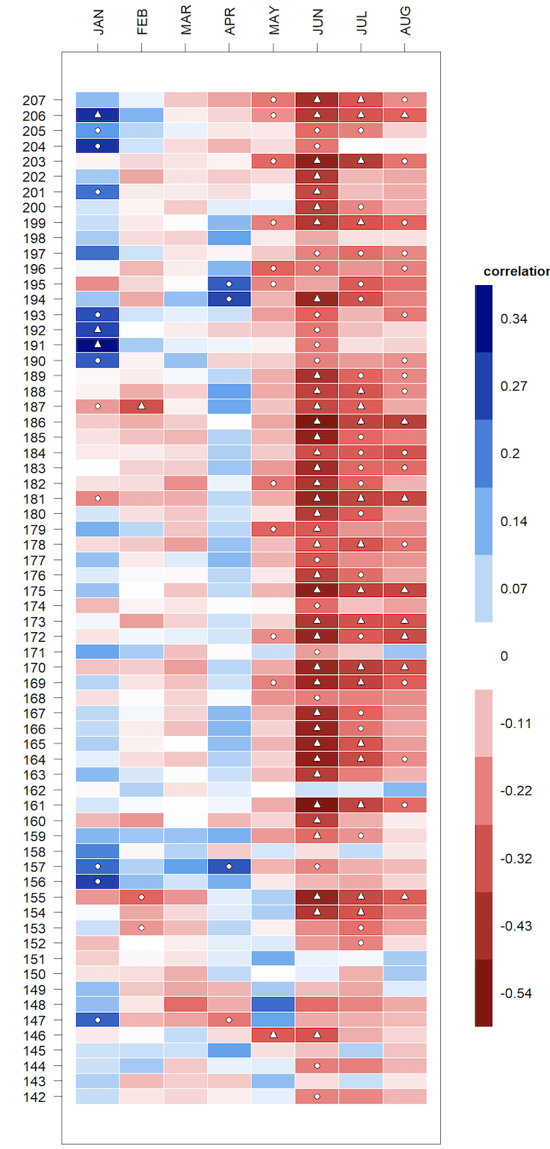
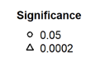
Ring porous
Diffuse porous
April T_{max}
+
SCBI
SCBI
Chronology number
HF
HF
-

Slide 2
Ring porous
Diffuse porous
April T_{max}
+
Chronology number
-
Notes:
Tmin

